Slide 1



Slide 2



Introduction to Universal Windows App development
SPEAKER NAME
DATE
EMAIL ADDRESS

Slide 3
Agenda
What are Universal Windows apps
Overview of dev platform
How to Distribute your apps

Slide 4
Windows Developer Platform
App Model
WinJS
(HTML + JS)
Windows XAML
(C# | VB | C++)
DirectX
(C++)
Windows Phone Silverlight
(C# | VB)
Services
Navigation
Store(s)
Packaging
Windows API Set
Push
Graphics
Audio
Media
Commerce
Contracts
Roaming
Networking
File System
Input
Sensors
Background
App Data Backup
Windows Runtime
.NET CLR
Windows Kernel
Legend
Windows + Windows Phone
Windows Only
Windows Phone Only

Slide 5
Increased API coverage across the Windows platform
The Windows Runtime (WinRT) is the shared runtime and API space used by apps across the Windows platform (phone and client)
Dramatic convergence in 8.1
Goal is 100% convergence for dev scenarios
Examples of differences: DirectAccess, Printing, Search, Wallet
Windows-specific WinRT APIs
Common WinRT APIs
Phone-specific WinRT APIs

Slide 6
Demo creating Universal Windows App
Flickr Search Demo
Notes:
Ok, lets dive into the real stuff and show you how you can build a real universal windows app. We will talk about the exact details later but first I want to show you how you can build an app for both windows and windows phone and reuse a lot of code.
Demo 1 (FlickrSearch demo) (make sure you setup the c# and XAML code snippets before you start, the END solution works if you get stuck during the demo)
Shared FlickrSearch Demo
Use some time to explain the tools as well
Emulator (there are multiple)
Save State of the emulator
Location
Network testing etc
Show off the visual studio tools
Explain the structure of the project, shared code etc.
See demo http://channel9.msdn.com/events/TechDays/Techdays-2014-the-Netherlands/Lap-around-Windows-Phone-8-1-Introduction-to-the-new-developer-platform
Starts at 20:00

Slide 7
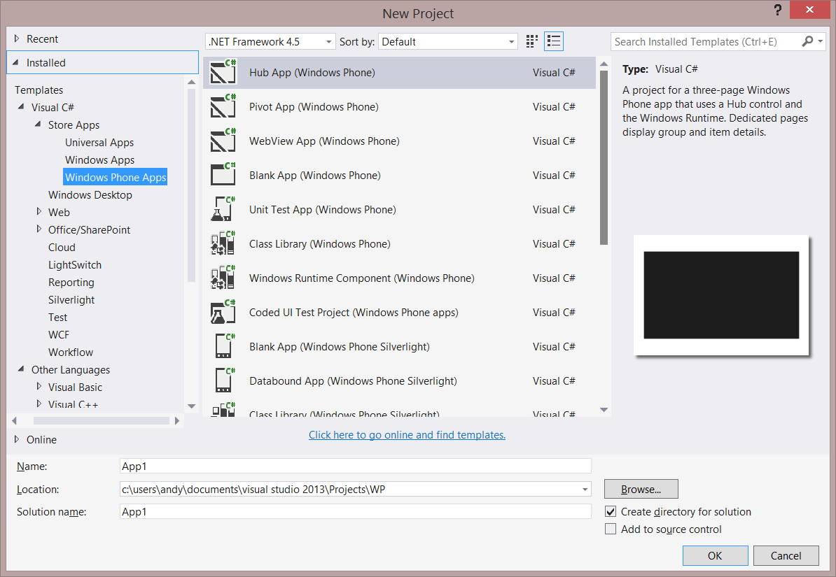
Creating Projects in Visual Studio 2013
Create Windows Runtime apps using XAML or HTML/JavaScript targeting:
Universal Windows and Windows Phone
Windows
Windows Phone
Can also create Windows Phone Silverlight apps targeting Windows Phone 8.0 or 8.1
Notes:
The Windows Phone 8.1 development tools are included in Update 2 and later for Visual Studio 2013 Professional or higher editions. Alternatively, you can download and install the completely free and standalone Visual Studio 2013 Express Editions for Windows Store Apps which allows development of Windows Store apps and Windows Phone Store apps.
Note that you can still build apps targeting Windows Phone 7.1 and these will run on Windows Phone 7.1 and later – including Windows Phone 8.1, but you cannot target version 7.1 from Visual Studio 2013. You must use Visual Studio 2012 for that.

Slide 8
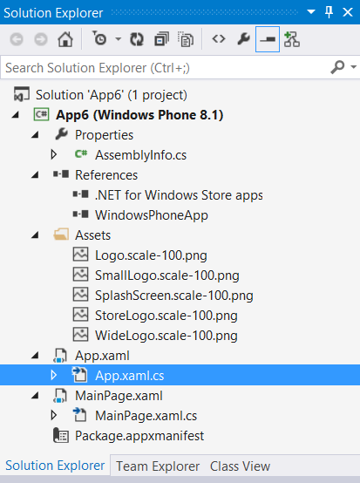
Anatomy of a WinRT App project
Solution name
Project name
Library references
App logos and other artwork
App class
Page class
App manifest
Notes:
When you create a new project in Visual Studio 2013, you get a single Solution which is the container for one or more projects.
[Build] This example shows a single project, but in a Universal project, you get two projects, one for Windows Phone and one for Windows. You can add many different kinds of project to a solution such as class libraries or unit test projects.
[Build] The library references shows the class libraries that this project references. You can add additional class library references to allow your project to make use of the APIs in a class library.
[Build] The Assets folder in a new project contains all the default artwork, which you’ll need to change for your project. Artwork doesn’t have to be in the Assets folder – that’s just the convention used by the New Project templates.
[Build] Every Windows Store App has an App class which is where the startup logic sits and where you define app-wide resources such as XAML styles. As you can see, it is defined in two files: the App.Xaml file containing XAML app-wide resources and the App.xaml.cs file where the logic is.
[Build] This new project has a single page, again divided up into a Xaml file and it’s code-beside file, MainPage.xaml.cs
[Build] Finally, the App manifest is an XML file where you make declarations about how the app operates and the capabilities it requires, such as whether it requires Internet access, or makes use of the user’s location.
For those familiar with the old Windows Phone structure:
- Assets are in line with Windows 8 for splash/tiles etc
- Package.appxmanifest replaces WMAppManifest to configure application properties

Slide 9
Overview of XAML and controls
Notes:
OK, lets dive into XAML for the people who are not familiar with this technology. You might have heard of it before, we use it in WPF and Silverlight and it’s also available for Windows Apps

Slide 10
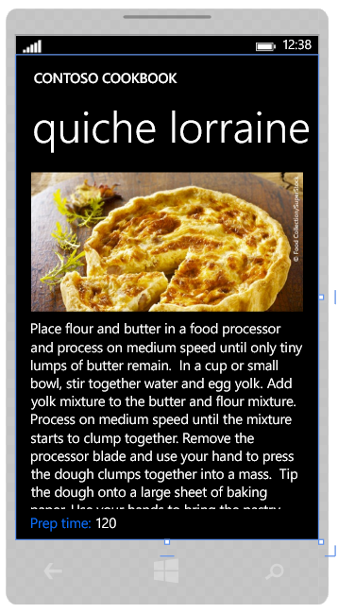
XAML and Pages
Each of the items on the page can be defined in XAML
Every XAML element is a declaration of an object
XAML stands for Extensible Application Markup Language
XAML is a way of describing a UI using XML
This is a declarative way of expressing your UI
XAML elements are objects in the Windows.UI.XAML namespace
XAML attributes map to setting properties on those objects
Notes:
XAML and Objects
Every visual element that makes up the UI of this application is actually just the graphical rendering of an object. All XAML UI is comprised of a ‘visual tree’ of objects.
This is standard UI fare – nearly all graphical programming systems work the same way.

Slide 11
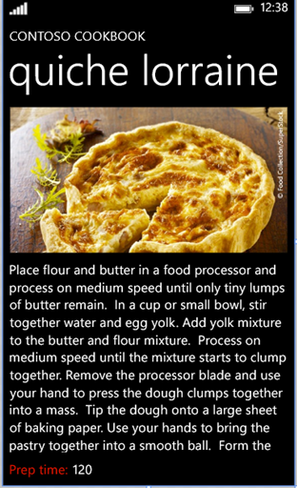
XAML Display Elements
Grid (Page Container)
StackPanel (stacks controls vertically)
TextBlock
TextBlock
Image
TextBlock
TextBlock
TextBlock
Grid (lays out content in rows and/or columns) – in this case three rows
StackPanel (stacks controls horizontally)
Notes:
XAML display elements
The page contains a number of display elements, each of which is represented by an object.
In fact, everything you see on the page is described in the XAML that is created to describe the page UI. When you drag a control from the Toolbox and drop it onto the design surface for the page, Visual Studio adds the XAML for the control into the XAML for the page.

Slide 12
Display Element Properties
Each of the elements has properties that define how it appears on the screen
Position on the screen
Height and width
Font color and size etc..
These values are used by XAML when the elements are drawn
Notes:
Display element data
XAML is a way of declaratively defining objects that can be rendered. The XAML defines the objects that makes up the page, and also sets the initial values of properties of those objects that is used when the page is first rendered, such as the style to use for text display, or the width and height of a button.
In our application code, we can manipulate these objects and change properties while the program is running. When this happens, the visual appearance of the affected element will change.

Slide 13
Panel Controls: Canvas, StackPanel, Grid…
Containers for other elements
Elements inside the panel are called “Children”
You can nest panels
The panel controls how the children are positioned
More on that when we discuss the layout process
Several panels included
Border, Canvas, StackPanel and Grid cover most common uses
Notes:
Panels are containers for elements
But, so are content controls, so how are panels different?
Panels are layouts for *multiple* elements. In order to have more than one child element, you need to derive from panel.
Because of this, panels often have non-trivial layout algorithms. The built-in ones offer grid, XY, and stacked positioning. Third-party and custom panels may support radial layout, or other approaches
XAML is extensible (that’s the “X” in XAML). So, of course, you can create your own panels as well. If you can think of a layout algorithm not well supported by the in-box panels, you can create a panel for it

Slide 14
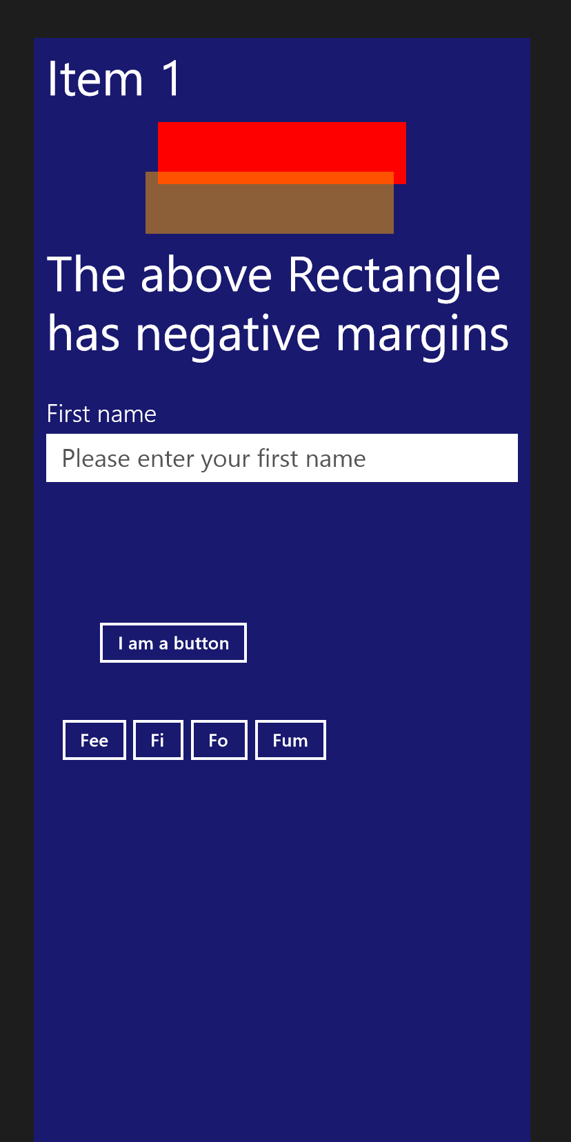
StackPanel
Margins and appropriate alignment are respected
<StackPanel Width="400" Background="MidnightBlue"> <TextBlock Text="Item 1" FontSize="40" Margin="10"/> <Rectangle Width="200" Height="50" HorizontalAlignment="Center" Fill="Red"/> <Rectangle Width="200" Height="50" HorizontalAlignment="Center“ Margin="-20,-10,0,0" Opacity="0.5" Fill="Orange"/>
<TextBlock Text="The above Rectangle has negative margins" TextWrapping="Wrap" Margin="10" FontSize="40" /> <TextBox Header="First name" FontSize="20" Margin="10“ PlaceholderText="Please enter your first name" />
<Button Content="I am a button" Margin="50,100,0,20" />
<StackPanel Orientation="Horizontal" Margin="20"> <Button Content="Fee" /> <Button Content="Fi" /> <Button Content="Fo" /> <Button Content="Fum" /> </StackPanel>
</StackPanel>
Margins and Alignment
Nested StackPanel
A StackPanel may have horizontal or vertical orientation
Notes:
The StackPanel lays out children in top to bottom or left to right order. For horizontal orientation, this may be reversed by changing the FlowDirection property. Typically this is done to support RTL languages.
Unlike with the Canvas, the Margin properties on the children are respected as part of layout. In a vertical stackpanel, HorizontalAlignment is respected. In a horizontal stackpanel, VerticalAlignment is respected.
As with other panels, StackPanels may be nested in each other or in other panels.
StackPanel is for layout where you want to have one element positioned after another. For example, items on a menu or listbox.

Slide 15
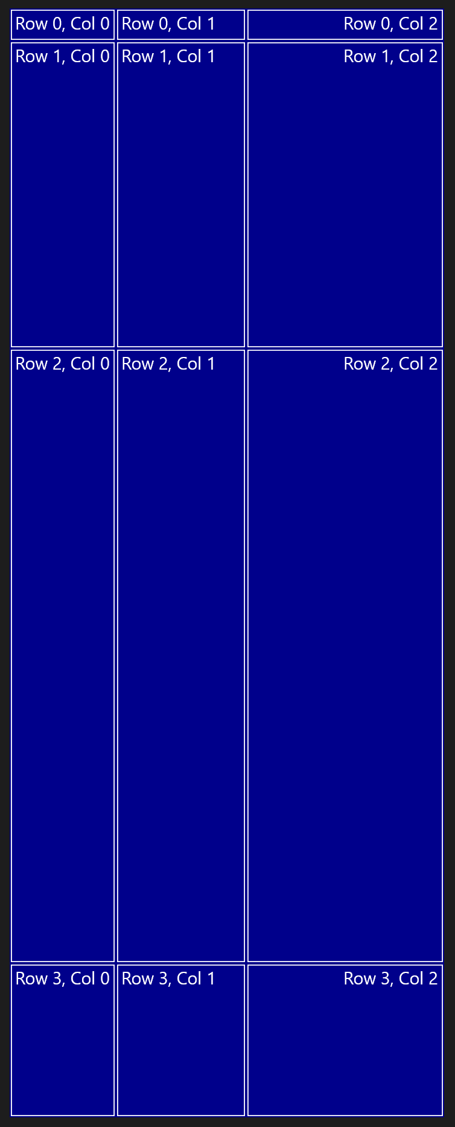
Grid
1.0*
Row and Column Definitions
<Grid Width="400" Background="DarkBlue" Margin="20"> <Grid.ColumnDefinitions> <ColumnDefinition Width="Auto" /> <ColumnDefinition Width="120" /> <ColumnDefinition Width="*" /> </Grid.ColumnDefinitions> <Grid.RowDefinitions> <RowDefinition Height="Auto" /> <RowDefinition Height="*" /> <RowDefinition Height="2*" /> <RowDefinition Height="0.5*" /> </Grid.RowDefinitions>
<Rectangle Stroke="White" Margin="1" Grid.Row="0" Grid.Column="0" /> <Rectangle Stroke="White" Margin="1" Grid.Row="0" Grid.Column="1" /> <Rectangle Stroke="White" Margin="1" Grid.Row="0" Grid.Column="2" />
.. <TextBlock Text="Row 0, Col 0" Margin="5" /> <TextBlock Text="Row 0, Col 1" Grid.Column="1" Margin="5" /> <TextBlock Text="Row 0, Col 2" Grid.Column="2" HorizontalAlignment="Right" Margin="5" /> .. </Grid>
2.0*
Rectangles
Labels
0.5*
Notes:
Grid is the most commonly used panel, but it is also the most layout intensive.
Grids respect margins and alignment. Children are positioned in rows and columns (consider these like cells) established through RowDefinition and ColumnDefintion properties.
By default all Grids have 1 row and 1 column, which is also the default cell if Grid.Row and Grid.Column are not specified on child elements.
When setting Grid row and column sizes, you can:
Use an absolute pixel value
Set to Auto so the row or column takes up only as much room as is required by its children
Use star sizing. The * is the remaining space. Multiple * entries mean to divide the remaining space between them. A multiplier like 2* means to give twice as much space as * is calculated to be. Similarly 0.5* means half as much space.
Grid is for complex layout where you want elements to be automatically sized based upon the available space.

Slide 16
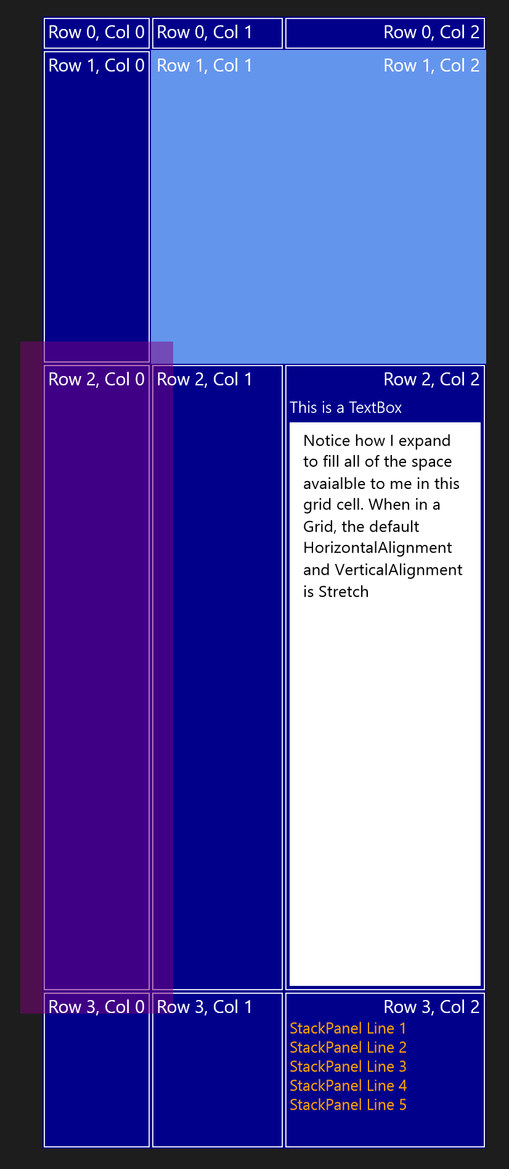
Grid
<Rectangle Grid.Row="1" Grid.Column="1" Grid.ColumnSpan="2“ Fill="CornflowerBlue" /> <Rectangle Grid.Row="2" Margin="-20" Opacity="0.5" Fill="Purple" />
<TextBox Grid.Row="2" Grid.Column="2" Header="This is a TextBox“ Margin="5,25,5,5" TextWrapping="Wrap“ Text="Notice how I expand to fill all... "/>
<StackPanel Grid.Row="3" Grid.Column="2" Margin="5,25,5,5"> <StackPanel.Resources> <Style TargetType="TextBlock"> <Setter Property="FontSize" Value="14" /> <Setter Property="Foreground" Value="Orange" /> </Style> </StackPanel.Resources> <TextBlock Text="StackPanel Line 1" /> <TextBlock Text="StackPanel Line 2" /> <TextBlock Text="StackPanel Line 3" /> <TextBlock Text="StackPanel Line 4" /> <TextBlock Text="StackPanel Line 5" /> </StackPanel>
Nested StackPanel
Notes:
The Rectangle and TextBox automatically expanded to fill all available space allocated to them. By default the elements HorizontalAlignment and VerticalAlignment properties are automatically set to stretch. The panel that makes best use of this is the Grid which can provide an entire cell to one or more children.
The light blue rectangle at the top uses the ColumnSpan attached property to span two columns. The RowSpan property is also available and may be used at the same time. The span is always relative to the row/column the element is located in, and will always span right and down.
Note as well that the Row & Col labels from the previous example are still displayed here. You may have any number of elements inside a given cell.
Row 3, col 2 has a nested StackPanel. As with other panels, the Grid may have other Grids, StackPanels or any other panel as a child. In UI design, it’s common to see grids nested a few layers deep to permit subdividing cells without having an excess of row and column spans for other elements.
Finally elements may have negative margins to extend beyond the row and column in which they have been placed. The purple semi-transparent rectangle demonstrates that.

Slide 17
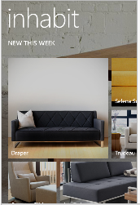


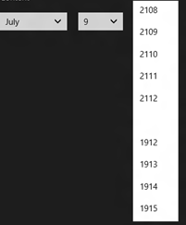
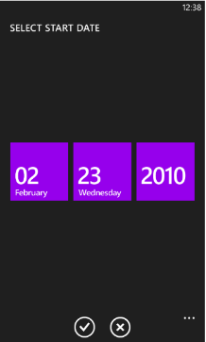

Converged Controls
What does it really mean?
80% exact same XAML
20% custom
Common
Optimized
DatePicker
TimePicker
CommandBar
Signature
Button
ToggleSwitch
Hub
Pivot
ListView
GridView
AppBar
SysTray
CheckBox
Slider
RadioButton
ProgressBar

Slide 18
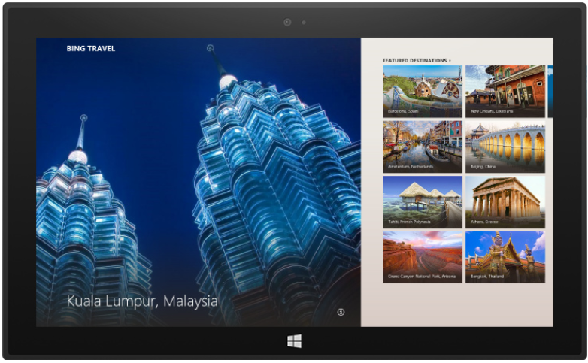
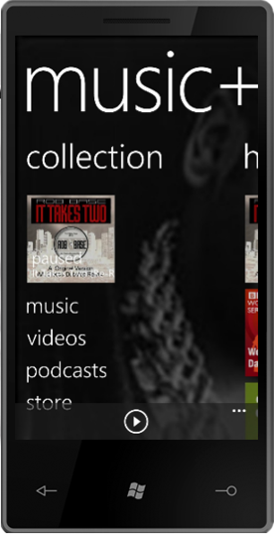

Controls that adjust for form factor
On Windows Phone 8.1
… and on Windows 8.1

Slide 19
Common canvas for Screen Diversity
10” tablet
5”
6”
7” tablet
4.5”
Shared virtual layout canvas
Provides a common layout coordinate system that extends along the x and y axis into infinity, allowing you to scale up
Infinite virtual canvas
166 Logical DPI
Notes:
1 logical pixel = 1/166th of an inch
Physical screen size determines how much of this canvas is available
Works for all screen sizes across the entire Windows ecosystem

Slide 20
Page navigation
Notes:
In this section, we talk about page navigation.
Page navigation is handled the same as on Windows and windows phone, on phone with some additional considerations around Back key handling.

Slide 21
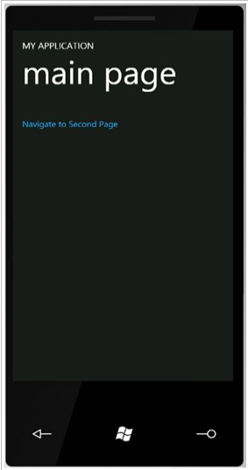
Windows, Frames and Pages
Window
Window
Frame
Page
The window contains a single frame, sized at 100% of area.
The frame contains pages, also typically sized at 100% of the area available to the window.
In Windows Store Apps for Tablet/PC, apps may have more than one window. On phone, apps have only one window.
Notes:
Pages contain your content. These is the XAML file and its associated code-behind.
The page is contained in a frame. Frames are responsible for navigation from page to page. Although app windows typically contain only a single frame you can have sub-page type navigation by embedding additional frames in the page, though this is rarely used in phone apps.
The frame maintains navigation history.
In Windows 8, each app had only one window. In Windows 8.1, tablet and PC apps may have multiple windows. In Windows Phone 8.1, each app only has a single window.
Each window has its own frame and navigation stack, and its own page.

Slide 22
The Frame and the Navigation BackStack
protected override void OnLaunched(LaunchActivatedEventArgs e)
{
Frame rootFrame = Window.Current.Content as Frame;
// Do not repeat app initialization when the Window already has
// content, just ensure that the window is active
if (rootFrame == null)
{
// Create a Frame to act as the navigation context and navigate // to the first page
rootFrame = new Frame();
...
// Place the frame in the current Window
Window.Current.Content = rootFrame;
}
if (rootFrame.Content == null)
{
// Navigate to the first page rootFrame.Navigate(typeof(MainPage), e.Arguments);
}
// Ensure the current window is active
Window.Current.Activate();
}
The Frame is created on app launch
Frame acts as the container for Pages
It maintains a navigation history as you navigate through pages
Frame.BackStack property, returns an IList<PageStackEntry>
Notes:
The OnLaunched method is in the App.xaml.cs file and contains startup logic. Here you see the code that creates the Frame when the app launches.
The Frame is placed in the current (single) Windows. Then when you call the Frame.Navigate(Type, object) method, a Page instance is created and is placed into the Frame.
As you navigate forwards and backwards through pages, the Frame records the navigation history.

Slide 23
Navigation between pages
private void itemListView_ItemClick(object sender, ItemClickEventArgs e) { // Navigate to the appropriate destination page, configuring the new page // by passing required information as a navigation parameter var itemId = ((MyListViewItem)e.ClickedItem).UniqueId; Frame.Navigate(typeof(MyDetailPage), itemId); }
You are responsible for context
When navigating to a page, you are responsible for providing any parameters/data using the “parameter” parameter of the Navigate method.
Notes:
To navigate to another page, call the Navigate method on the frame. This handles putting the current page in the back stack, and also passing any provided parameters to the new page.
Note that you pass in a type, not an actual page instance or a URI. This is because pages may be cached. Caching is controlled by the Page’s NavigationCacheMode property which we will look at in a moment.

Slide 24
Navigation overrides
OnNavigatedTo
Called when the user navigates to this page
Load data, populate fields, wire-up event handlers, etc.
OnNavigatedFrom
Called when this page is no longer active in the frame, typically when a user navigates away
Do any tear-down in this method
Notes:
These are the two most important page activation methods. OnNavigatedTo is fired when the page is to be displayed. OnNavigationFrom is fired when the page is being left.
Here is where you handle the itemID from the previous page

Slide 25
Page Navigation Demo
Notes:
Demo Session 3 Demos\1 – Page Navigation END
S3 Demo Script
You can do the typing (start with BEGIN) or just demo the app and break at the navigate part.

Slide 26
Windows Runtime App lifecycle
Notes:
Another important part to understand well when building WinRT apps is the App lifecycle. Look at the web, not every webpage is running all the time. This is the same for apps on Windows and on windows phone.
There is a reason why we can’t leave all apps in memory. For example on 512MB phones there isn’t much memory to go around. When using apps we still want to be able to receive phonecalls, sync email, listen to Spotify music on my Bluetooth headset and be able to receive VOIP calls from Skype as well. Memory in this situations is really a constraint.
The amount of memory on desktops or laptops is different obvisouly but you should take into account your app might be running on a range of different devices.

Slide 27
Process lifetime walkthrough
Running
App 1
App 2
App 3
…
App N
Apps suspend after a short delay
Apps resume instantly from suspend
Suspended
App terminated under memory pressure without notification
Terminated
Notes:
Apps are suspended 5 seconds after leaving foreground.
However, you get 10 seconds instead when you switch from one App to another.
You can check it if you launch an App in Snap view and keep the Task Manager in the Filled view (I’m not able to find a workflow that ends up to the 5 seconds…)
Suspended Apps are notified before being suspending
After that event, no more CPU for the application threads
If you take too long to suspend… you’ll get terminated
Windows is free to “terminate” any Windows Store App if memory pressure is detected
Terminated Apps are not notified before being terminated
See http://msdn.microsoft.com/en-us/library/windows/desktop/aa366541(v=vs.85).aspx for API to use to detect when memory is running high/low
See http://blogs.msdn.com/b/b8/archive/2012/04/17/reclaiming-memory-from-metro-style-apps.aspx for details about memory management based on Working Set metrics in Windows 8

Slide 28
Suspend
System resources focused on the app that the user is interacting with in the foreground
Inactive apps have no impact on battery life or responsiveness, they are suspended by the OS
Enables instant switching between apps
Notes:
This also visible with SysInternals Process Explorer (http://technet.microsoft.com/en-us/sysinternals/bb896653.aspx) where you see the same “Suspended” in the CPU column. It was possible to “suspend” a process in Windows 7 with Process Explorer: this is now done by Windows itself for Windows Store Apps.
NOTE: Process Explorer is fully aware of Windows Store Apps = “Immersive” has new blue color. See Options | Configure Colors | Immersive Process + see package in tooltip
When you right-click | Resume on a Suspended Windows Store App, it gets back automatically Suspending immediately by Windows

Slide 29
Termination
User explicitly closes the app: soft termination
System needs more memory
User switch occurs (on Windows)
System shutdown
Apps crash
Apps do not get notified when they are being terminated
Notes:
The user can still decide to explicitly “close”/”end” an App by using ALT+F4 or the following touch gesture = “drag the top of the App and drag it down to the bottom of the screen”: in that case, the App gets the suspend notification after 5 seconds
The system is also allowed to “terminate” the apps.. [users can do it too via task manager or Process Explorer, or by dragging to the bottom of the screen and then holding until the app flips to the splash screen]
There is no event fired during termination… you should save all your stuff by “suspending” or even better, along the user navigation in the App

Slide 30
Registering for Suspend and Resume is easy
// Register for the Suspending event and call OnSuspending when received App.Current.Suspending += OnSuspending;
// Handle the suspending event and save the current user session using WinJS sessionState void OnSuspending(object sender, Windows.ApplicationModel.SuspendingEventArgs e) { // We are getting suspended }
// Register for the Resuming event and call OnResuming when received App.Current.Resuming += OnResuming;
void OnResuming(object sender, object e) { // We are getting resumed, in general do nothing }
Notes:
Suspending:
You have 5 seconds real time (not CPU time) to save what you need to save. If you take too long, the App will be terminated. Even when you use deferral for asynchronous processing.
Resuming:
Sometimes useful for checking for updates in case of a News App for example.
Ex: you’ve stored the time of suspension and, on resuming, if there are more than x hours since then, the code checks for News updates.
NOTE: when the App gets suspended, all the event handlers are still registered (sockets, system related,…) but will never get any CPU to run even if such an event occurs.

Slide 31
Best Practices for saving and restoring state
Scenario | You should….
User is using your App | Save user data incrementally
App switched away from (Suspending) | Save where the user is – what screen they are on, for example
Not running App launched by user (Activated) | Bring the user back and restore their session as if they never left
Suspended App launched by user (Resuming) | Do nothing
Notes:
Because apps can be stopped when in the background, and restarted when the user navigates back to the app you have to think about saving state and what makes sense. Here are some best practices

Slide 32
Multitasking

Slide 33
Multitasking: Background Tasks and Triggers
Notes:
Multitasking: through Background Tasks activated by Triggers.
Trigger-based execution:
Apps will subscribe to triggers they are interested in
Only run *when* trigger is fired
Example:
Geofencing
BLE beacon
Push notification
Task completion
Allows apps to finish what they’re doing for up to 10 minutes
Opportunistic so app can be unloaded if under resource pressure

Slide 34
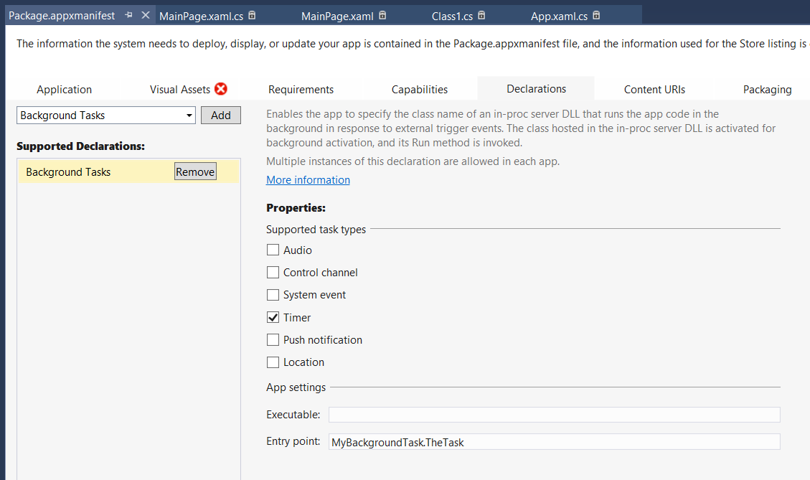
Registration needs manifest entry
should not have to specify an executable for the background task host here.
Notes:
In the manifest editor, you must declare your background task or tasks using the Declarations tab – note that you can add ‘Background Tasks’ multiple times if your app supports more than one. You must select the correct task type your app uses.
You do not have to specify a background task host executable here but you must type in the Entry point in the format namespace.type, as shown in the screen shot here.

Slide 35
Background tasks and triggers demo
Notes:
Open up the demo in Seesion 11 demos Demo 2 App1
Follow the script for S11 background Tasks Demo script
Show the declarations in the appxmanifest file

Slide 36
But there is much, much more
Maps and geolocation
Tiles and notifications
Sensors and proximity
Contacts
Appointments
Data binding
Contracts
Camera, media & audio
SQLLite
Authentication/SSO
Data
Localization
Speech
Bluetooth
Notes:
Point people to jumpstart and absolute beginners

Slide 37
How do you distribute apps to your users

Slide 38
App deployment options
Through the store (public distribution)
Sideloading (private distribution)
beta apps (phone only)
hidden apps with deeplink (phone only)
public apps
MDM like Intune, Airwatch, Mobile Iron etc
Website or email

Slide 39
Public apps versus Private apps
Similarities
Differences
Standard Windows apps
Same API Set
Same app security model
Familiar tools (C#, XAML, Visual Studio)
Create by and for company
Available only for company employees
Not distributed via the store
Not certified by Microsoft

Slide 40
Thank You

Slide 41
Resources
Jumpstart
http://channel9.msdn.com/Series/Building-Apps-for-Windows-Phone-8-1
Absolute beginners
http://channel9.msdn.com/Series/Windows-Store-apps-for-Absolute-Beginners-with-C-
http://channel9.msdn.com/Series/Windows-Phone-8-1-Development-for-Absolute-Beginners
Deploying and managing enterprise apps
http://channel9.msdn.com/events/TechEd/NorthAmerica/2014/WIN-B217

Slide 42
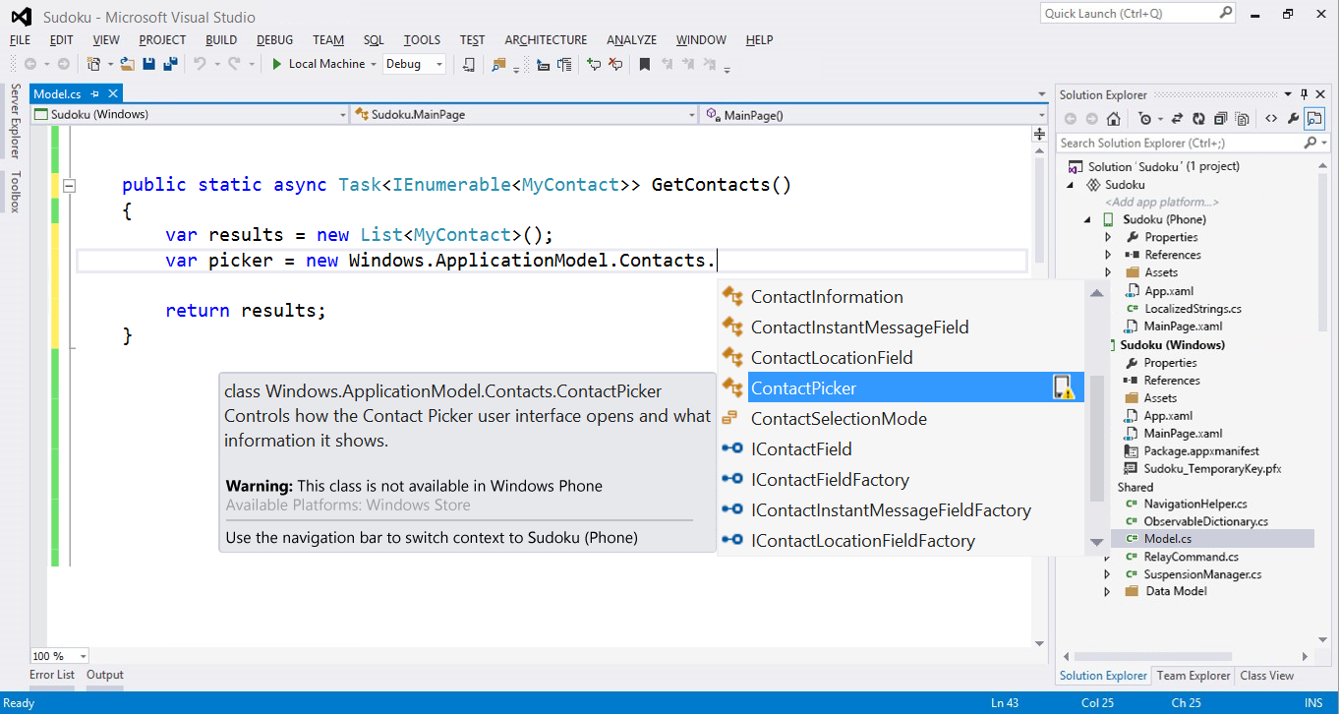
IDE Improvements

Slide 43
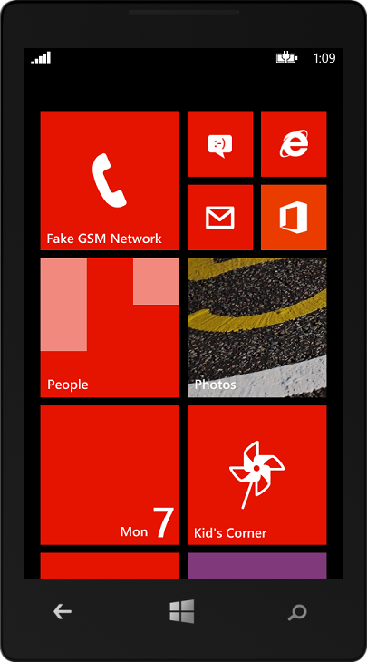

SDK Tools
Hyper-V based emulator improvements:
Network
Multi-touch emulation with mouse
SD card
Location improvements
Push simulation
Locally simulate push notifications
Save and load data samples

Slide 44
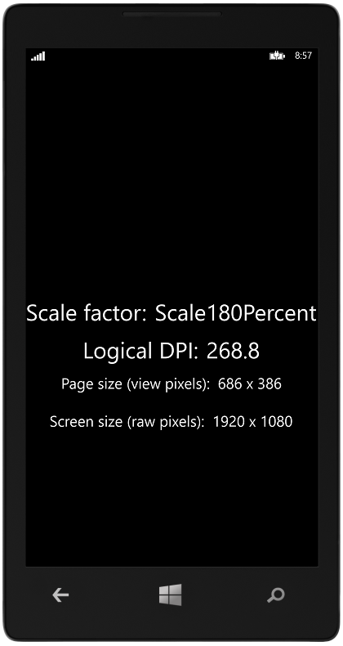
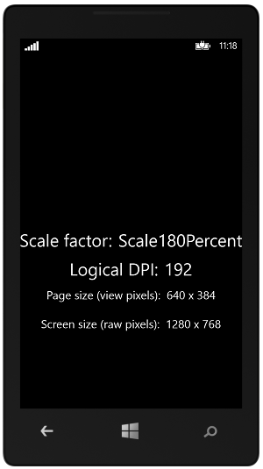
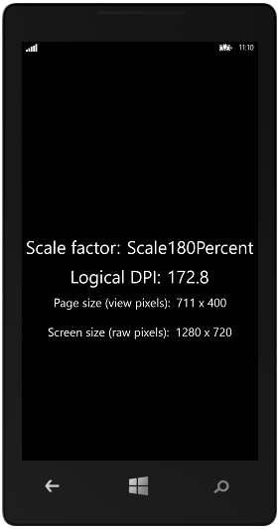
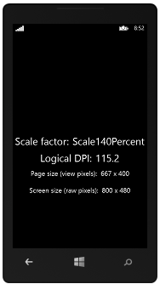
Emulators
Emulator 8.1 1080p
Emulator 8.1 WXGA
Emulator 8.1 720p
Emulator 8.1 WVGA

Slide 45
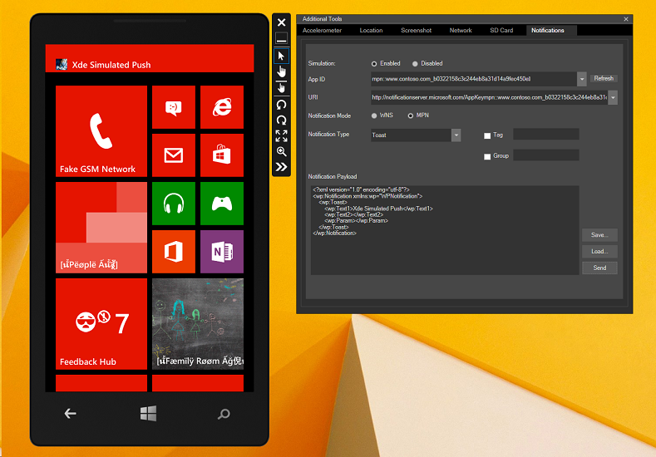
Push Simulation
Locally simulate push notifications
Save and load data samples

Slide 46
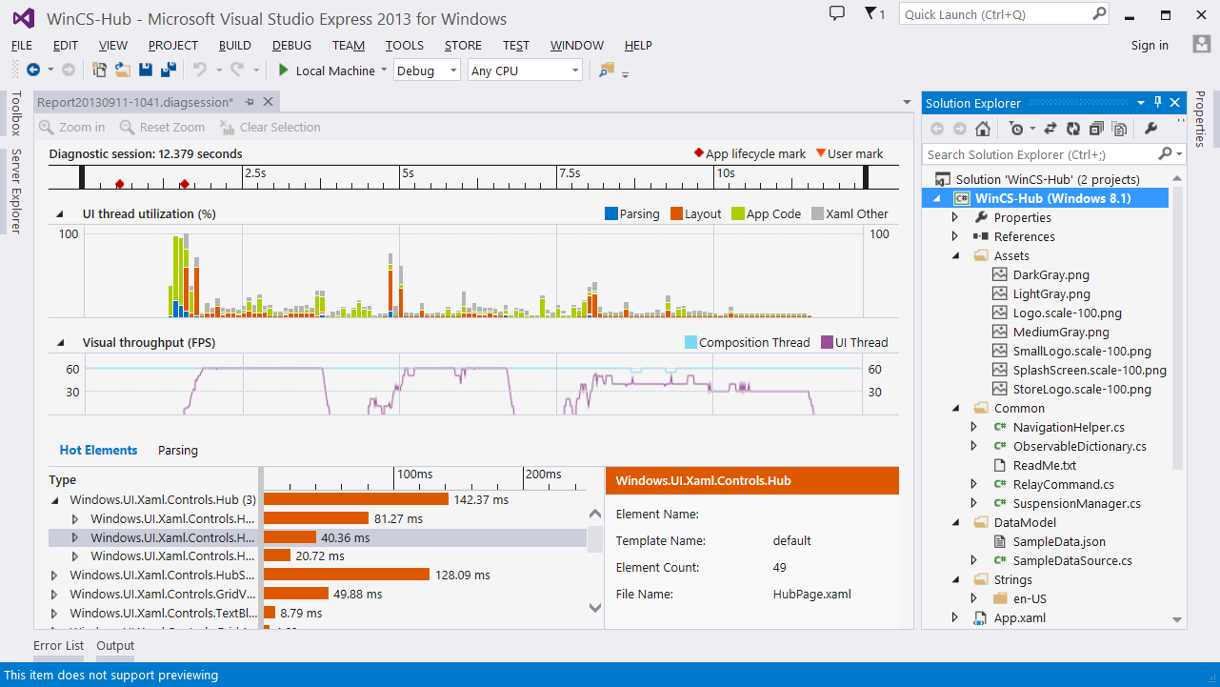
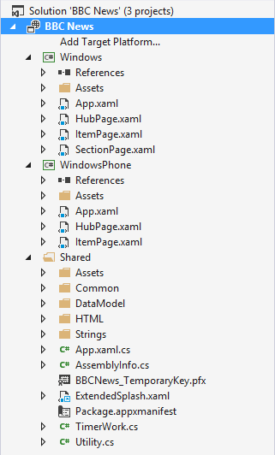
XAML Diagnostic Improvements
UI responsiveness
Identify hot elements
Startup and page rendering
UI thread utilization
Frames per second

Slide 47
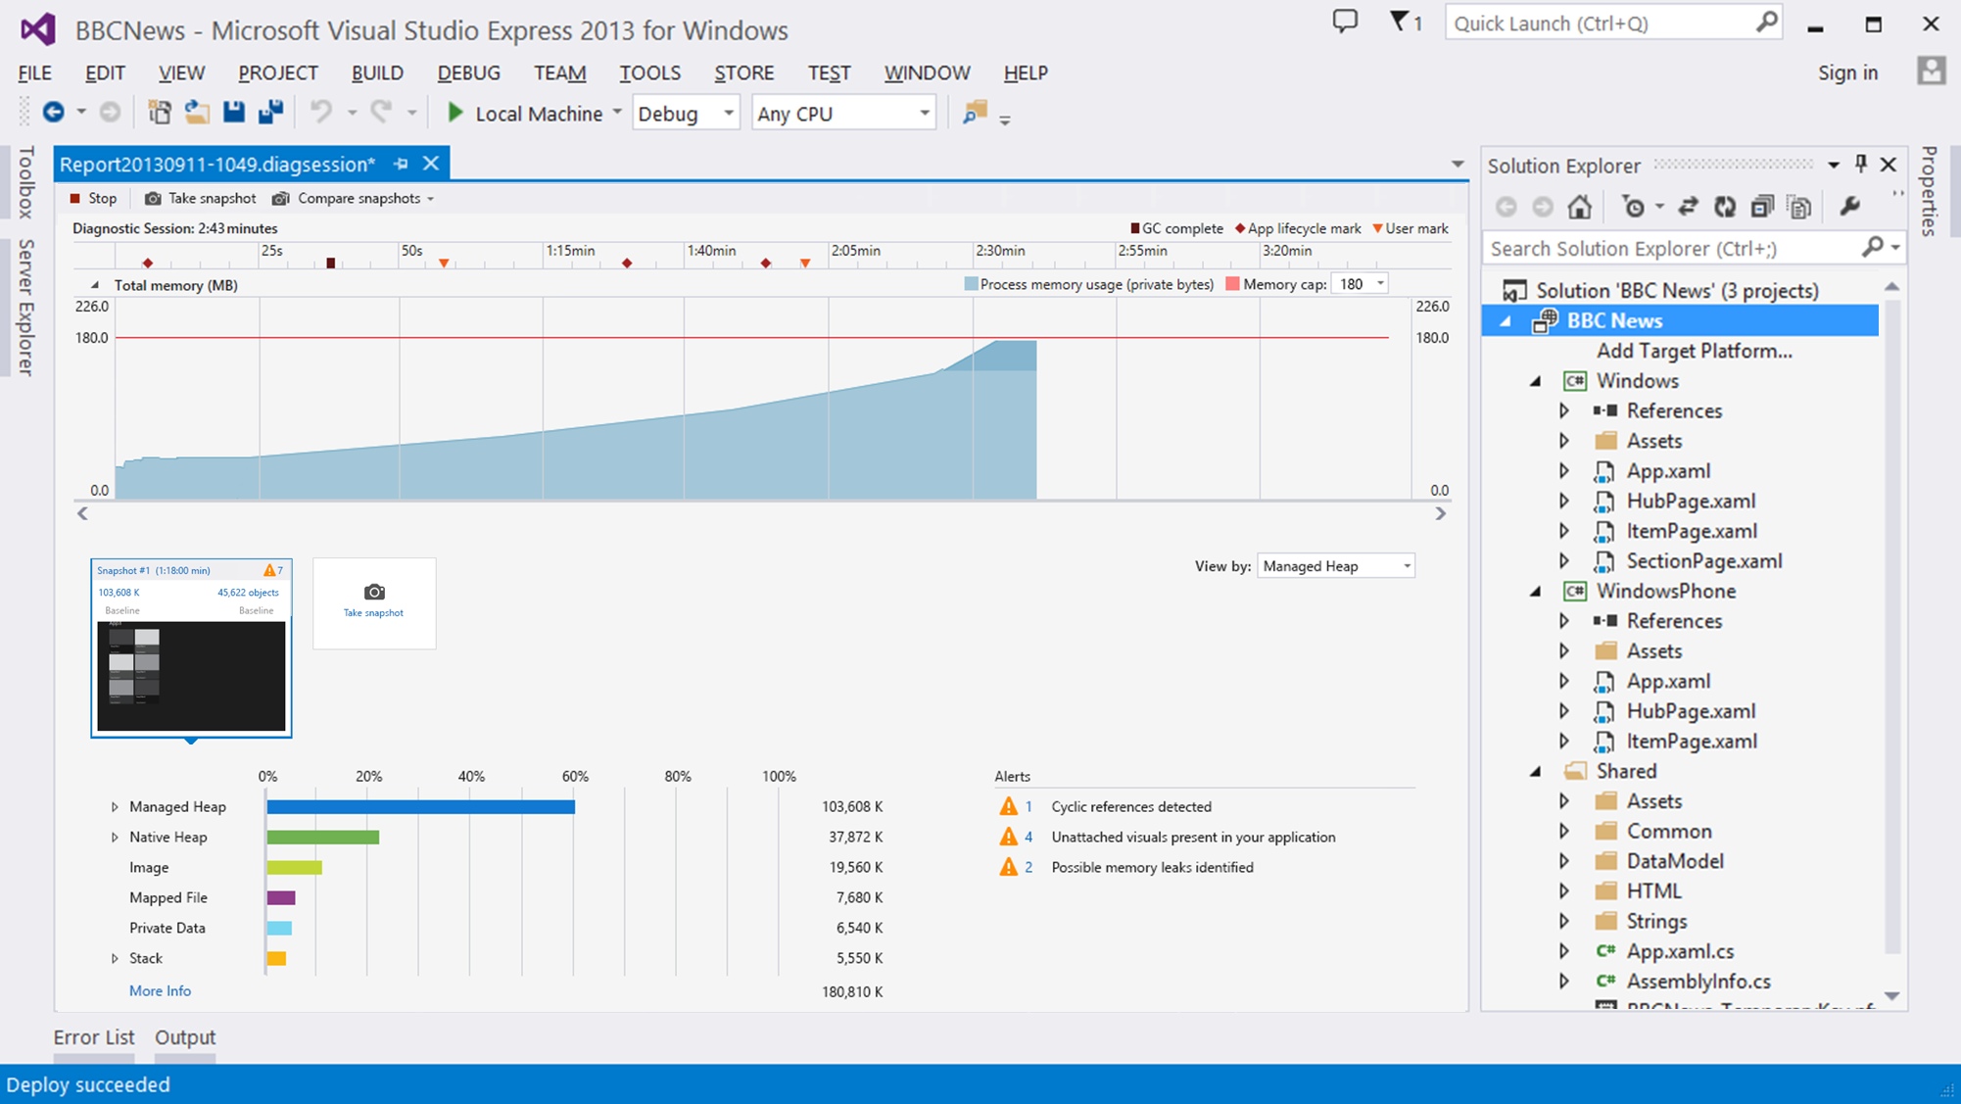
XAML Diagnostic Improvements
Memory profiler
View memory growth over time
Inspect & analyze both native and managed memory snapshots
Automatically analyze and report issues like leaks and unattached visuals

Slide 48
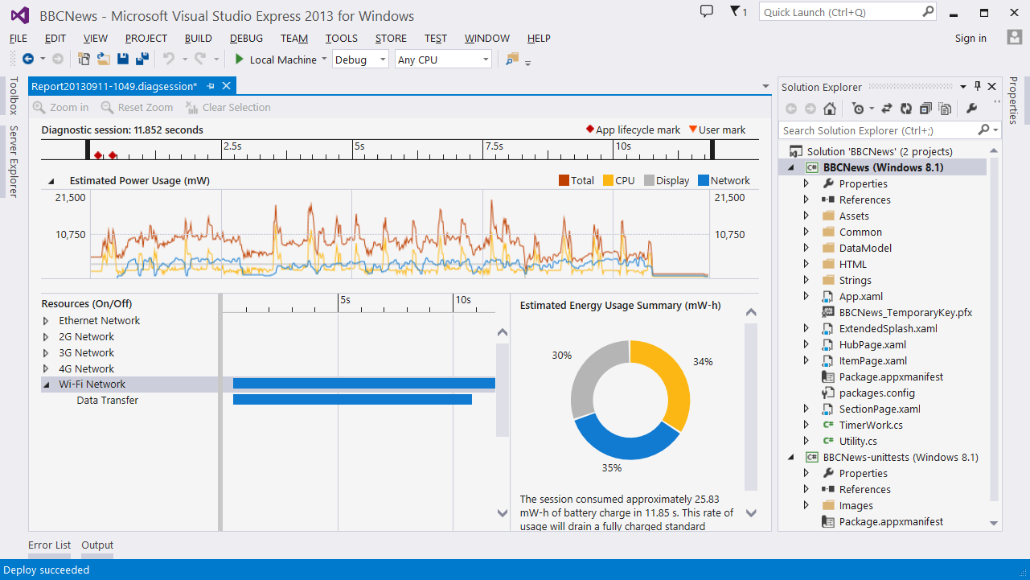
XAML Diagnostic Improvements
Energy profiler
View energy consumption by resource

